Slide 1
Big Data Bioinformatics
By: Khalifeh Al-Jadda

Slide 2
Is there any thing useful?!

Slide 3
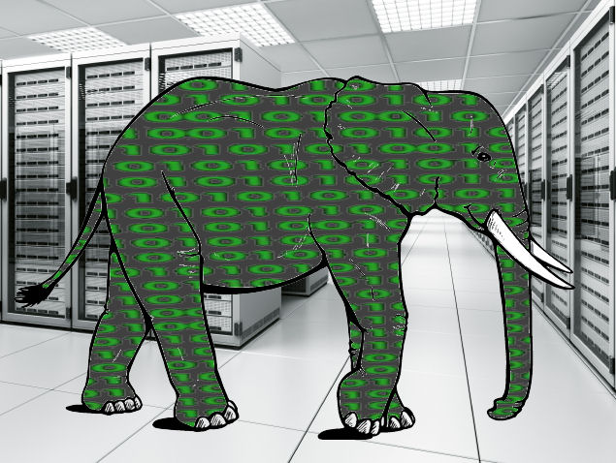
What is Big Data?
Volume
Variety
Velocity
35 Zettabytes
800,000 Petabytes
2020
2009
1 ZB = 10⁶ PB

Slide 4
Solutions

Slide 5
Motivation
The 1000 genomes project will produce 1 petabyte of data per year from multiple sources in multiple countries.
The Reciprocal Smallest Distance (RSD) algorithm to generate orthology groups requires:
((N)(N-1)/2)*M
Where N is the number of genomes and M represents the number of different parameter settings for evalue and divergence.
With 1000 genomes and 12 parameters
the total number of processes required for a full complement of results would be 5,994,000. Further assuming that each individual process takes on average 4 hours (generally a lower bound for big genomes), and constant access to 300 cores of computer processing power, the total time to complete this task would be 79,920 hours, or 9.1 years
Cloud computing for comparative genomics

Slide 6
Motivation
Asian Individual Genome was assembled based on 3.3 billion reads ( 104 GB).
African Individual Genome was assembled based on 4 billion reads ( 144 GB).
Alignment > 10,000 CPU hours

Slide 7
Motivation
InterPro is an integrated documentation resource for protein families, domains, regions and sites.
InterPro combines a number of databases (referred to as member databases) that use different methodologies and a varying degree of biological information on well-characterised proteins to derive protein signatures.
PANTHER, PIRSF, Pfam, SMART, TIGRFAMs, Gene3D and SUPERFAMILY: are providers of hidden Markov models (HMMs).

Slide 8
Motivation
Searching unknown sequences:
10,000 average proteins
1 average HMM (239 states)
= 1.18 CPU sec
BUT,
17,159,442 proteins
44,117 HMMs
= 1.4 million CPU hrs

Slide 9
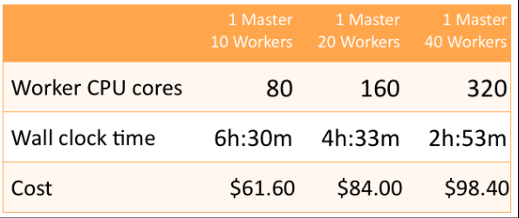
Success
Crossbow (implemented over Hadoop) condenses over 1000 CPU hours of resequencing computation into a few hours without requiring the user to own or operate a computer cluster.

Slide 10
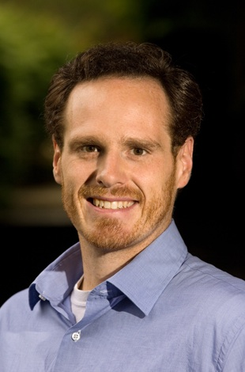
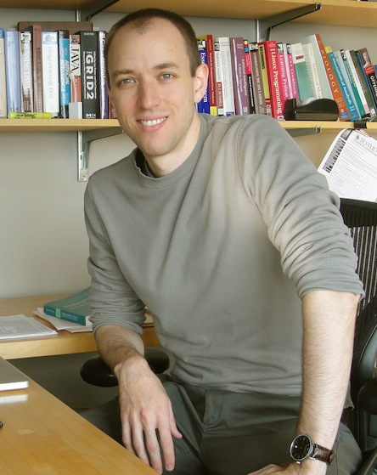
Bioinformatics projects
Dennis P. Wall
CloudBurst
Michael C. Schatz
Contrail
Crossbow
Ben Langmead

Slide 11
CloudBurst
Is a new parallel read-mapping algorithm optimized for mapping next-generation sequence data to the human genome and other reference genomes , for use in a variety of biological analyses including SNP discovery, genotyping, and personal genomics.
It reports either all alignments or the unambiguous best alignment for each read with any number of mismatches or differences.
This level of sensitivity could be prohibitively time consuming, but CloudBurst uses the open-source Hadoop implementation of MapReduce to parallelize execution using multiple compute nodes.

Slide 12
Roundup
Is a large-scale orthology database. The orthologs are computed using the Reciprocal Smallest Distance (RSD) algorithm.
This algorithm detects more (and more accurate) orthologs than reciprocal best blast hits and gives each ortholog a score based on its maximum likelihood evolutionary distance.
Every release of Roundup downloads the latest genomes from UniProt and computes orthologs for them.

Slide 13
Bioinformatics Tools
Tool | Platform | Authors
BLAST | Hadoop | M. Gaggero
Gene Set Enrichment Analysis (GSEA) | Hadoop | M. Gaggero
GRAMMAR | Hadoop | M. Gaggero
NCBI BLAST2 | Hadoop | Andrea Matsunaga
MSA | Hadoop | Sadasivam
SeqWare query engine | Hbase | Brian O’Connor

Slide 14
Glad Tiding
Hadoop and Hbase have been installed on a cluster at NERSC (40 nodes soon to double).
Users interested in using cloud for their research may fill out the Magellan Cloud Computing statement of interest form.

Slide 15
Thanks

